Slide 1

DECISION TREES: INTUITION
Decision Trees are supervised Machine Learning technique where the data is split according to a certain condition/parameter.
Let’s assume we want to classify whether a customer could retire or not based on their savings and age.
Savings>$1M
AGE
Yes
No
45 years
Age > 45?
Class #0
Yes
No
Class #1
Class #0
$1 Million
SAVINGS

Slide 2
DECISION TREES: DEFINITIONS
The tree consists of decision nodes and leaves.
Leaves are the decisions or the final outcomes.
Decision nodes are where the data is split based on a certain attribute.
Objective is to minimize the entropy which provides the optimum split
DECISION NODES
Savings>$1M
Yes
No
Age > 45?
Class #0
Yes
No
LEAVES
Class #1
Class #0

Slide 3
DECISION TREES: CUSTOMER SEGMENTATION
Credit Score<750
CREDIT SCORE
Yes
No
Income<$200K
Income<$100K
750
Yes
No
Yes
No
650
Class #1
Credit Score<650
Class #0
Class #1
Yes
No
$100K
$200K
INCOME
Class #0
Class #1

Slide 4
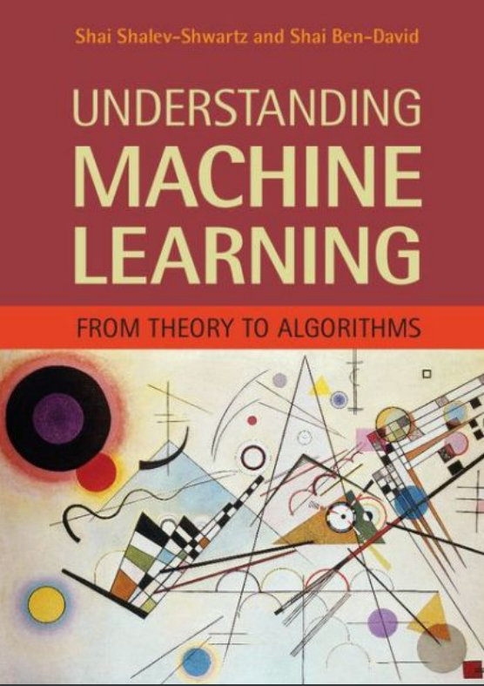
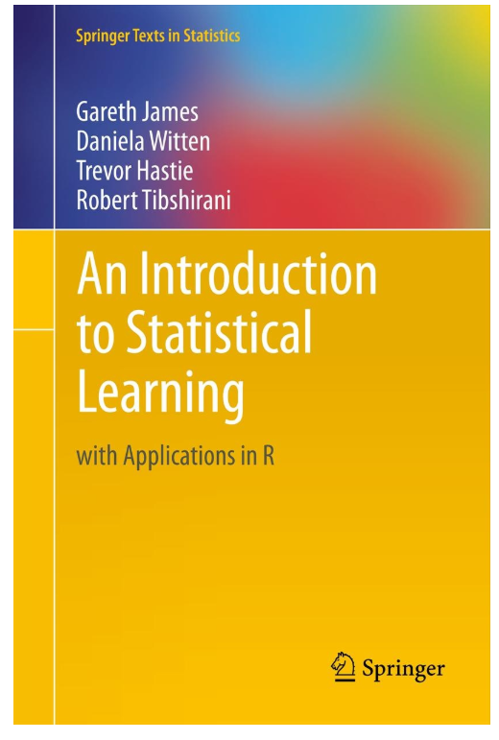
DECISION TREES: ADDITIONAL READING MATERIAL
Additional Resources, Page #250: http://www.cs.huji.ac.il/~shais/UnderstandingMachineLearning/understanding-machine-learning-theory-algorithms.pdf
Additional Resources, Page #303:
http://www-bcf.usc.edu/~gareth/ISL/ISLR%20Seventh%20Printing.pdf

